Slide 1

Data Structures & Algorithms 1/12
“Introduction”
02nd April 2018
Dr. Rasika Ranaweera (ranaweera.r@nsbm.lk | +94 11 544 6126)
School of Computing | NSBM
Notes:
Brief self introduction and high level definition about architecture in general.
Find some statistics about CA at NSBM.
Job Market

Slide 2
Session Plan
Session | Module Content
Session 01/02 | Introduction to Data structures and algorithms and time complexity analysis Big O notation
Session 03 | Stacks and Queues
Session 04 | Linked Lists
Session 05 | Quiz 1, Linear and Binary Search
Session 06 | Sorting Algorithms: Simple
Session 07/08 | Sorting Algorithms: Advance
Session 09 | Recursion
Session 10/11 | Tree Concepts, Tree Traversal, Binary Search Tree
Session 12 | Recap and Model Paper Discussion Final Quiz

Slide 3
Algorithm
An algorithm is a sequence of computational steps that transform an input into an output.
Example:
Sorting Problem
Input: A sequence of n numbers
Output: A permutation (reordering) of the input sequence

Slide 4
Definition: Algorithm
A computer algorithm is a detailed step by step method for solving the problem
An algorithm is a sequence of clear-cut instructions for solving the problem in a finite amount of time.
More generally an algorithm is any well defined
computational procedure that takes collection of elements as input and procedures collection of elements as output.
An algorithm is a set of rules for carrying out calculation either by hand or on a machine.
An algorithm is an abstraction of a program to be executed on a physical machine (model of computation).

Slide 5
Design and Analysis of Algorithms
The “design” pertain to:
the description of algorithm at an abstract level by means of a pseudo language, and
Proof of correctness that is, the algorithm solves the given problem in all cases
The “analysis” deals with performance evaluation (complexity analysis)

Slide 6
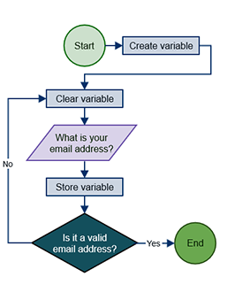
Algorithm

Slide 7
How do you learn algorithms to cook?
To become good chef, you don’t learn lots of recipes by heart.
study existing recipes.
practice making them.
experiment with one’s own variations.
Until one can invent their own recipes.

Slide 8
How do you learn about algorithms?
A good computer scientist doesn’t need to memorize a big book of algorithms:
We will begin studying famous algorithms.
You can practice executing them by hand.
Once you recognize more general patterns, you can
experiment with your own variations.
At the end of the course, invent algorithms yourself.

Slide 9
Analysis of Algorithms
The theoretical study of computer-program performance and resource usage. What’s more important than performance?
modularity
correctness
maintainability
functionality
robustness
user-friendliness
simplicity
extensibility
reliability

Slide 10
Algorithms, Programming
A good understanding of algorithms is essential for a good understanding of the most basic element of computer science
i.e. programming.
Unlike a program, an algorithm is a mathematical entity, which is independent of a specific programming language, machine, or compiler.
Thus, in some sense, algorithm design is all about the mathematical theory behind the design of good programs.

Slide 11
Why study algorithms and performance?
Algorithms help us to understand scalability.
Performance often draws the line between what is feasible and what is impossible.
Algorithmic mathematics provides a language for talking about program behavior.
Performance is the currency of computing.

Slide 12
Why Study Algorithms?
Necessary in any computer programming problem
Improve algorithm efficiency: run faster, process more data, do something that would otherwise be impossible
Solve problems of significantly large sizes
Compare algorithms
Algorithms as a field of study
Learn about a standard set of algorithms
New discoveries arise
Numerous application areas
Learn techniques of algorithm design and analysis
how does one coordinate the efforts of many programmers working on a single piece of software

Slide 13
Applications
Multimedia
CD player, DVD, MP3, JPEG, DivX
Internet
Packet routing, data retrieval (Google)
Communication
Cell-phones, e-commerce
Computers
Circuit layout, file systems
Science
Human genome
Transportation
Airline crew scheduling, UPS deliveries

Slide 14

Roadmap
Different problems
Sorting
Searching
String processing
Graph problems
Geometric problems
Numerical problems
Different design paradigms
Divide-and-conquer
Incremental
Dynamic programming
Greedy algorithms
Randomized/probabilistic
NP Completeness
•

Slide 15

Analyzing Algorithms
Predict the amount of resources required:
memory: how much space is needed?
computational time: how fast the algorithm runs?
FACT: running time grows with the size of the input
Input size (number of elements in the input)
Size of an array, polynomial degree, # of elements in a matrix, # of bits in the binary representation of the input, vertices and edges in a graph
Def: Running time = the number of primitive operations (steps) executed before termination
Arithmetic operations (+, -, *), data movement, control, decision making (if, while), comparison

Slide 16
Combinatorial Problems
These are problems that ask (explicitly or implicitly) to find a combinatorial object such as:
Permutation
Combination
That satisfies certain constraints and has some desired property.
E.g.
Traveling Salesperson problem

Slide 17
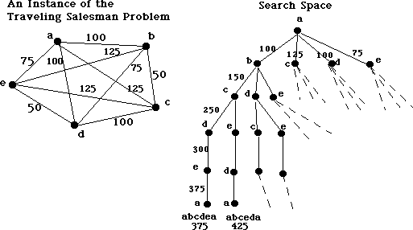
Traveling Salesperson Problem

Slide 18
Algorithms Analysis
How to analyze an algorithm?
Predicting the resources that the algorithm requires:
Memory
Communications Bandwidth
Computational time

Slide 19
Algorithms Analysis (Cont...)
Two parameters of measuring algorithm’s efficiency
Time Efficiency
How fast an algorithm in question runs
Space Efficiency
It deals with the extra space the algorithm requires

Slide 20
Algorithms Time Complexity Analysis
We do not
Determine the actual number of CPU cycles
Want to count every instruction executed
We want a measure that is independent of the
Computer
Programming language
Programmer
Compiler used for coding

Slide 21
Definition: Data Structures
A data structure is systematic way of organizing and accessing data with a specific relationship between the elements.
Why data structures?
Main purpose is to write efficient programs. In order to do that, one needs to organize the data in such a way that it can be accessed and manipulated efficiently.

Slide 22
Data Structures (Cont…)
A data structure is an aggregation of data components that together constitute a meaningful whole.
A data
structure is a way of arranging data in a
computer's memory or other disk storage.
A data structure is a collection of data, organized so that items can be stored and retrieved by some fixed techniques.
Example: Suppose you are hired to create a database of names with all company's management and employees.

Slide 23
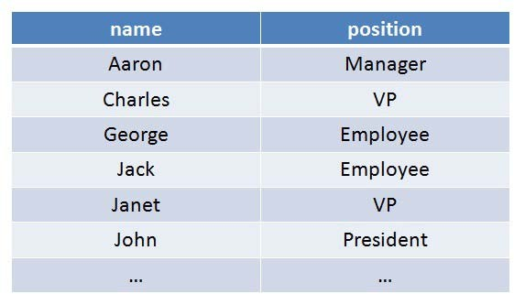
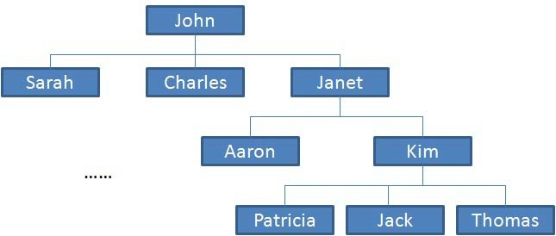
Example of Data Structures
You can make a list. You can also make a tree.

Slide 24
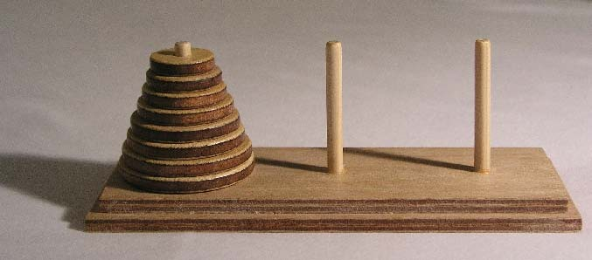
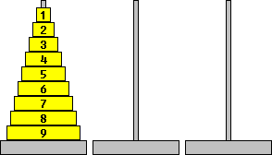
Example of Data Structures (Cont…)
You can use stack data-structure as Hanoi tower.

Slide 25
Data Structures Types
There are several common data structures: arrays, linked lists, queues, stacks, binary trees, hash tables, etc.
These data
structures can be classified as
either linear or nonlinear data structures, based on how the data is conceptually organized or aggregated.

Slide 26























Data Structures Classification
Direct Access |  | Array
Linear
List
Data Structures
Sequential Access
Stack (LIFO)
Queue (FIFO)
Trees
Non-Linear
Hash Table
Graphs

Slide 27
Linear Vs Non-Linear Data Structures
Linear Structures | Non-Linear Structures
Array, list, queue, and stack belong to this category. Each of them is a collection that stores its entries in a linear sequence. They differ in the restrictions they place on how these entries may be added, removed, or accessed. Common restrictions include FIFO and LIFO. | Trees and graphs are classical non- linear structures. Data entries are not arranged in a sequence, but with different rules.

Slide 28
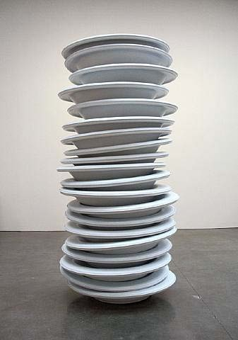


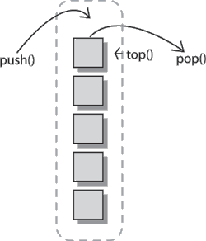
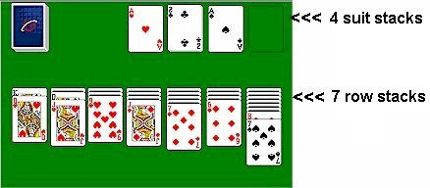
Common Examples Stack

Slide 29
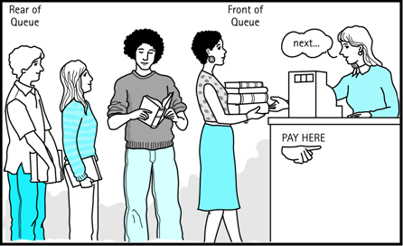
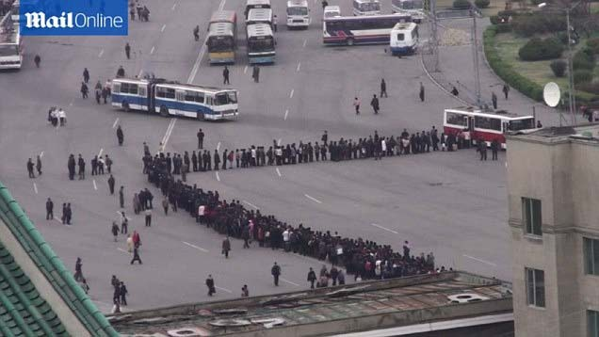

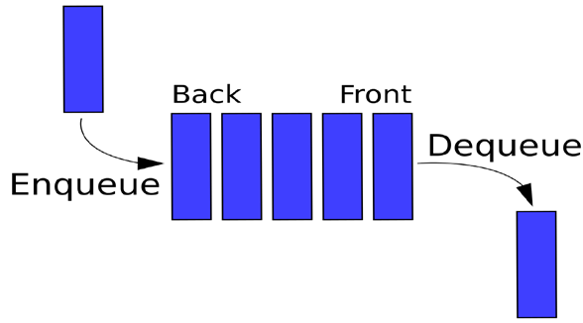

Common Examples Queue

Slide 30
Abstract Data Types (ADT)
First thing while writing programs is
to consider
the problem. Problems in real life are complicated. Description of these problems in a simple, precise language is required.
Example: consider a program that manages the student records. A University Administrator asks you to create a program which allows to administer the students in a class.
Vague problem -> Simplify it. What student information is needed for the record? What operations should be allowed?

Slide 31
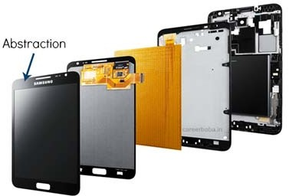
Example of Abstraction
The abstract view of a Cell-Phone:
Abstraction is hiding all the details
User concern only with display icons and Applications.
Unconcerned: About what are the inputs of the applications , or how circuit inside was constructed.

Slide 32
Abstract Data Type
An ADT is a mathematical model of a data structure that
specifies the type of data
stored, the types
the operations supported on them, and
of parameters of the operations.
An ADT specifies what each operation does, but not how it does it.
Typically, an ADT can be implemented using one of many different data structures.
Useful first step in deciding what data structure to use in a program is to specify an ADT for the program.

Slide 33
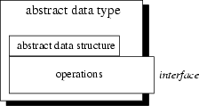
List ADT
Component:
Item
Operations: Insertion Deletion Search Display

Slide 34
String
A string is a sequence of characters from an alphabet.
Strings of particular interest are:
Text strings
Bit strings
Gene sequences

Slide 35
String Operations
String is a sequence of consecutive characters which ends with ‘\0’.
String Operations along with the syntax can be:
Operations | Traditional Syntax
Length | Length(string);
Concatenation | Concate(string1, string2);
Comparison | Compare(string1, string2);
Copy | CopyString(string1, string2);
Substring | Substring(string, strt_position_int, end_position_int);

Slide 36
String Operations (Cont…)
Operations | Description | Example
Length | The number of characters in the string | LENGTH(‘COMPUTER’)=8, LENGTH(‘ ’)=?
Concatenation | To combine two strings into one. | S1=‘Hello’, S2=‘Pakistan’ then S1 + S2= ‘HelloPakistan’ But S1+ ‘ ’ + S2= ‘Hello Pakistan’
Comparison | To compare any two strings Returns < 0, if (String 1 < String 2) Returns =0, if (String1 == String 2) Returns >0, if (String 1> String 2) | S1=‘Hello’, S2= ‘Pakistan’ then ? COMPARE(S1, S2)=? S1=‘Welcome to Java’, S2= ‘Welcome to C’ then COMPARE(S1, S2)=?
Copy | To copy the characters of one string to the another | S1=‘Data Structures’, S2=‘Algorithms’ Then Copy_String=(S1, S2) = ‘Algorithms’
Substring | Display the part of string | SUBSTRING(‘The End’, 4, 4)=?

Slide 37

Length of String
Length(char*str)
{
int count=0; while(*str!=‘\0’)
{
count++; str++;
}
return(count);
}
Str=1
Str=2
Str=3
Str=4
Str=5
Str=6
H
E
L
L
O
‘\0’
C=1
C=2
C=3
C=4
C=5
Note: *str refers to the value place at str
While str is the position

Slide 38

Concatenation of String
Concat(char*str1, char*str2)
{
Str1=1 Str1=2 Str1=3 Str1=4 Str1=5
Str1=6
while(*str1!=‘\0’) str1++;
while(*str2!=‘\0’)
{
*str1=*str2;
H | E | L | L | O | ‘\0’
Str2=1
Str2=2
Str2=3
Str2=4
Str2=5
Str2=6
W | O | R | L | D | ‘\0’
str1++; str2++;
Str1 Str1 Str1 Str1 Str1 Str1 Str1 Str1 Str1 Str1 Str1
=1 =2 =3 =4 =5 =6 =7 =8 =9 =10 =11
}
str1=‘\0’;
}
H | E | L | L | O | W | O | R | L | D | ‘\0’
Note: *str refers to the value place at str
While str is the position
53

Slide 39
String Comparison
Value | Relation between Compared String and Comparing String
0 | They compare equal
< 0 | Either the value of the first character that does not match is lower in the compared string, or all compared characters match but the compared string is shorter.
> 0 | Either the value of the first character that does not match is greater in the compared string, or all compared characters match but the compared string is longer.
39

Slide 40

Questions
40

